Slide 1
Doodle Classifier
SAMIN ISLAM
ID - 18101444

Slide 2
Motivation
Fun Project, classifying hand drawing doodles in an online game platform.
Quick Draw! (Link: https://quickdraw.withgoogle.com/ )
Inspired by -
Quick, Stat!: A Statistical Analysis of the Quick, Draw! Dataset; paper link: https://arxiv.org/pdf/1907.06417.pdf
Coding Train; Doodle Classifier. Youtube Link - https://www.youtube.com/watch?v=pqY_Tn2SIVA
Dataset Collected - Kaggle competition. Link - https://www.kaggle.com/c/quickdraw-doodle-recognition
Largest doodling dataset (345 categories, each containing hundreds of thousands of sketches)

Slide 3
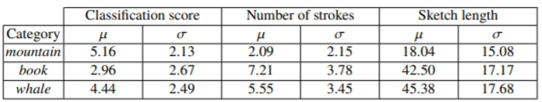
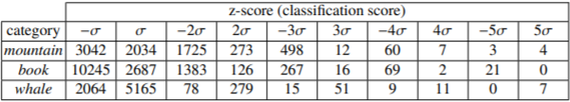
Available researches regarding this task
A statistical analysis based on three parameters -
the classification score (a Recurrent Neural Network (RNN) using LSTM layers)
number of strokes performed
the sketch length that is the total number of line segments defining the sketch.
Three categories from the dataset - mountain, whale, book
Arithmetic mean and the standard deviation of the
distribution of sketches as a function of the
3 parameters
Z-score, giving an impression of the number of
outliers in the dataset.
https://arxiv.org/abs/1907.06417; Quick, Stat!: A Statistical Analysis of the Quick, Draw! Dataset, 23 Oct, 2019.

Slide 4
Problem Statement
Handling the huge quickdraw dataset
Processing the strokes points, how to convert into images
Limited RAM
Unrecognized images
Possible best accuracy for different doodles

Slide 5
Methodology
Preprocessing -
Randomly selected - 15 categories, 150 from each category
Convert strokes to RGB input images(shape - 224x224x3)
Unrecognised images dropped
Manual random shuffle of X & Y
Labels converted into one hot vector
Model -
VGG16(base model) + 1 flatten layer + 3 dense layers(following dropout layer in each ) + prediction layer.
dropout rate = 0.2 , training set - 85%, testing/validation set = 15%
Optimizer - Adam
Loss - categorical crossentropy
Evaluation metric - categorical accuracy

Slide 6
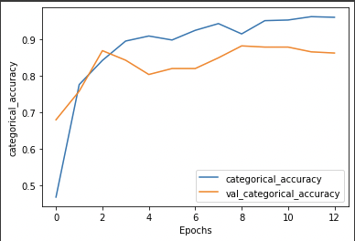
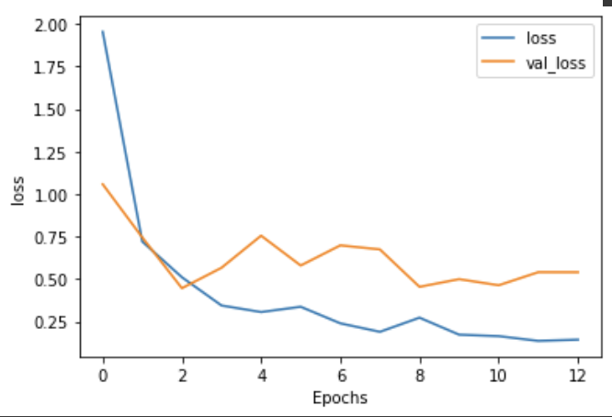
Results & Discussion
Accuracy
Loss

Slide 7
Conclusion(Limitations & Future Work)
Limitations
Limitations on RAM; huge dataset,
Some images in the dataset is distorted and absolutely unrecognizable, unnecessary for training the model,
More dataset is needed to train the model for better classification.
Future work
If the limitation mentioned above can be prevented, all the data can be used for better accuracy as the model requires huge amount of data for its best performance,
The size of the image can be increased too for recognizing each image better,
Using GAN can generate new doodles by the model, and can be used these newly generated images for the classification task of the Google’s Quick Draw! online site. As the site identifies the drawings of the users by NN models, newly generated images can be a small yet great contribution to the Google.

Slide 8
Colab Link -
https://colab.research.google.com/drive/1oc0cdaSrqqj7TFgohSTdMBNsgqgcOGMT?authuser=0#scrollTo=4j40HxSFnyx2&uniqifier=3

